Slide 1
Exception handling
Ashwin athreya h s

Slide 2
Exception
An event, which occurs during the execution of a program, that disrupts the normal flow of execution’s instructions
Occurs when our code ask jvm to perform the technically impossible

Slide 3
Exception Hierarchy
All Exception are part of built-in class Throwable
Throwable has two sub-classes
Error
Exception

Slide 4
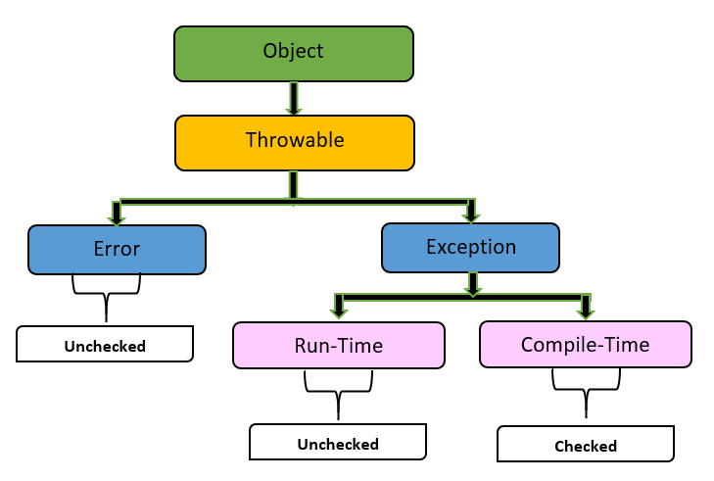
Exception Hierarchy

Slide 5
Errors
Error hierarchy describes internal errors and resource exhaustion
Relatively rare
Mostly beyond programmers control

Slide 6
Types of exceptions
Checked Exceptions
Compile time Exceptions
Should be handled by the programmer
Unchecked exceptions
Runtime Exceptions
JVM handles the exception

Slide 7
Unchecked exceptions
Null-Pointer Exception
Class-Cast Exception
Arithmetic Exception
public class UncheckedExceExple {
public static void main(String[] args) {
int a = 10, b = 0;
try {
int result = a / b;
System.out.println("Result:" result);
} catch (ArithmeticException e) {
System.out.println("An ArithmeticException occurred:"+ e.getMessage());
}
}
}

Slide 8
Keywords for java exception
Throws
Throw
Try
Catch
Finally

Slide 9
Try-catch
import java.io.File;
import java.io.FileNotFoundException;
import java.util.Scanner;
public class CheckedExceptionExample {
public static void main(String[] args) {
File file = new File("nonexistentfile.txt");
try {
Scanner scanner = new Scanner(file);
} catch (FileNotFoundException e) {
System.out.println("File not found: " + e.getMessage());
}
}
}

Slide 10
Throws-Throw
import java.io.IOException;
public class CheckedExceptionExample {
public static void main(String[] args) {
try {
throwIOException();
} catch (IOException e) {
System.out.println("Caught IOException: " + e.getMessage());
}
}
public static void throwIOException() throws IOException {
throw new IOException("This is an IO Exception.");
}
}

Slide 11
finally
import java.io.*;
class GFG {
public static void main(String[] args) {
try {
System.out.println("inside try block");
System.out.println(34 / 2);
} catch (ArithmeticException e) {
System.out.println("Arithmetic Exception");
} finally {
System.out.println( "finally : I execute always.");
}
}
}

Slide 12


